Slide 1


Indian
Independence day

Slide 2
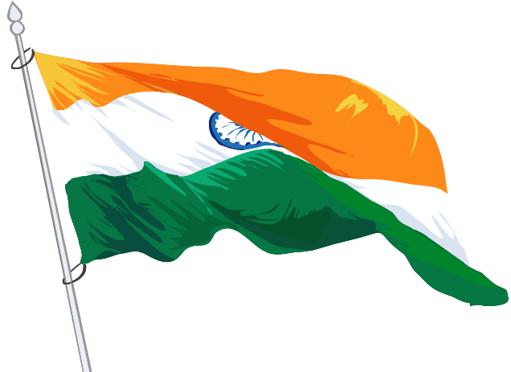

By
Pawan Mahadu Sarule
Roll no : 92 Question; 6
Class : FYBCA(sci)

Slide 3
Introduction
Independence Day is celebrated annually on 15 August as a national holiday in India commemorating the nation's independence from the United Kingdom on 15 August 1947, the day when the provisions of the Indian Independence Act 1947, which transferred legislative sovereignty to the Indian Constituent Assembly, came into effect. India retained King George VI as head of state until its transition to a full republic, when the nation adopted the Constitution of India on 26 January 1950 (celebrated as Indian Republic Day) and replaced the dominion prefix, Dominion of India, with the enactment of the sovereign law Constitution of India. India attained independence following the Independence Movement noted for largely non-violent resistance and civil disobedience.

Slide 4

Independence coincided with the partition of India, in which British India was divided along religious lines into the Dominions of India and Pakistan; the partition was accompanied by violent riots and mass casualties, and the displacement of nearly 15 million people due to religious violence.
On 15 August 1947, the first Prime Minister of India, Jawaharlal Nehru raised the Indian national flag above the Lahori Gate of the Red Fort in Delhi. On each subsequent Independence Day, the incumbent Prime Minister customarily raises the flag and gives an address to the nation.
The entire event is broadcast by Doordarshan, India's national broadcaster, and usually begins with the shehnai music of Ustad Bismillah Khan.
Independence Day is observed throughout India with flag-hoisting ceremonies, parades and cultural events. It is a national holiday.

Slide 5
Celebration
Flag hoisting ceremonies and cultural programs take place in governmental and non-governmental institutions throughout the country. Schools and colleges conduct flag hoisting ceremonies and cultural events. The Indian national anthem, "Jana Gana Mana", is sung. Major government buildings are often adorned with strings of lights. In Delhi and some other cities, kite flying adds to the occasion. National flags of different sizes are used abundantly to symbolize allegiance to the country.
Citizens adorn their clothing, wristbands, cars, household accessories with replicas of the tri- color. Over a period of time, the celebration has changed emphasis from nationalism to a broader celebration of all things India.

Slide 6
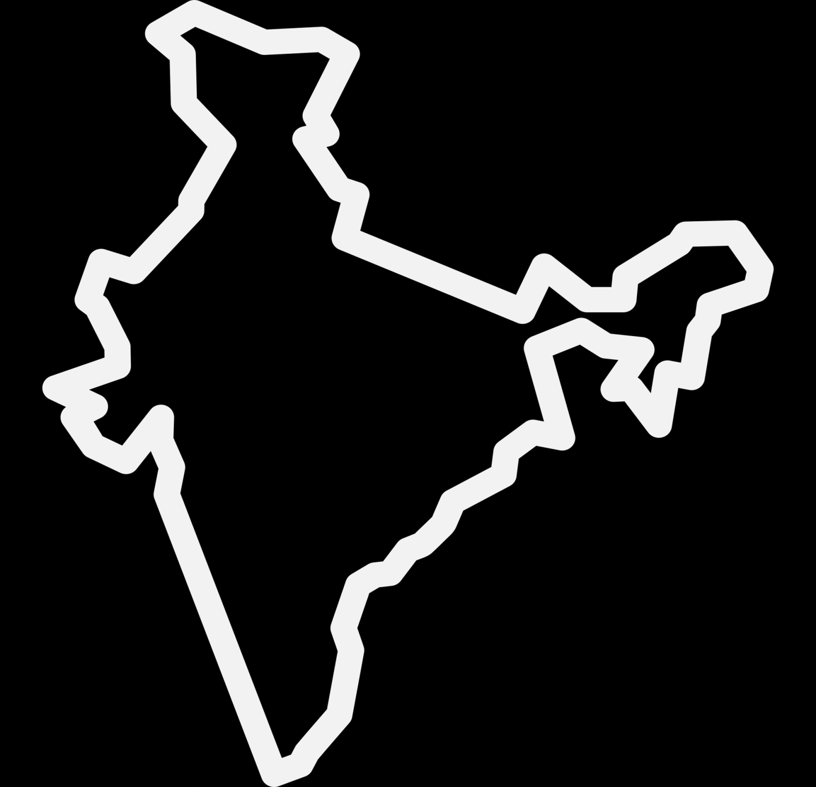


Ceremony
The Beating Retreat ceremony, organised at the Vijay Chowk on Independence Day every year. The ceremony includes performance by the bands of three wings of the military - Indian Army, Indian Navy and Indian Air Force at Raisina Hills.
The beating retreat ceremony is a ritual of lowering the national flags of both the countries (India and Pakistan) just before the sunset.
The Beating Retreat ceremony marks a centuries-old military tradition when the troops ceased fighting, sheathed their arms and withdrew from the battlefield and returned to the camps at sunset at the sounding of the Retreat.

Slide 7
Bio
1628 - 1633
Portuguese East India Company
The Indian independence movement was a series of historic events with the ultimate aim of ending the British rule in India. The movement spanned from 1857 to 1947. The first nationalistic revolutionary movement for Indian independence emerged from Bengal.
1858–1947
British Raj
1757–1858
Company rule in India
Mahatma Gandhiji
1947
Partition of India

Slide 8
Thank You

